Slide 1
THE BENELUX UNION CROSS-BORDER COOPERATION FOR THE WELL-BEING OF CITIZENS AND BUSINESSES
LIVING TOGETHER
FREE FROM
BORDERS
Beyond Borders Breakfast Debate
Thursday 13 July 2023

Slide 2
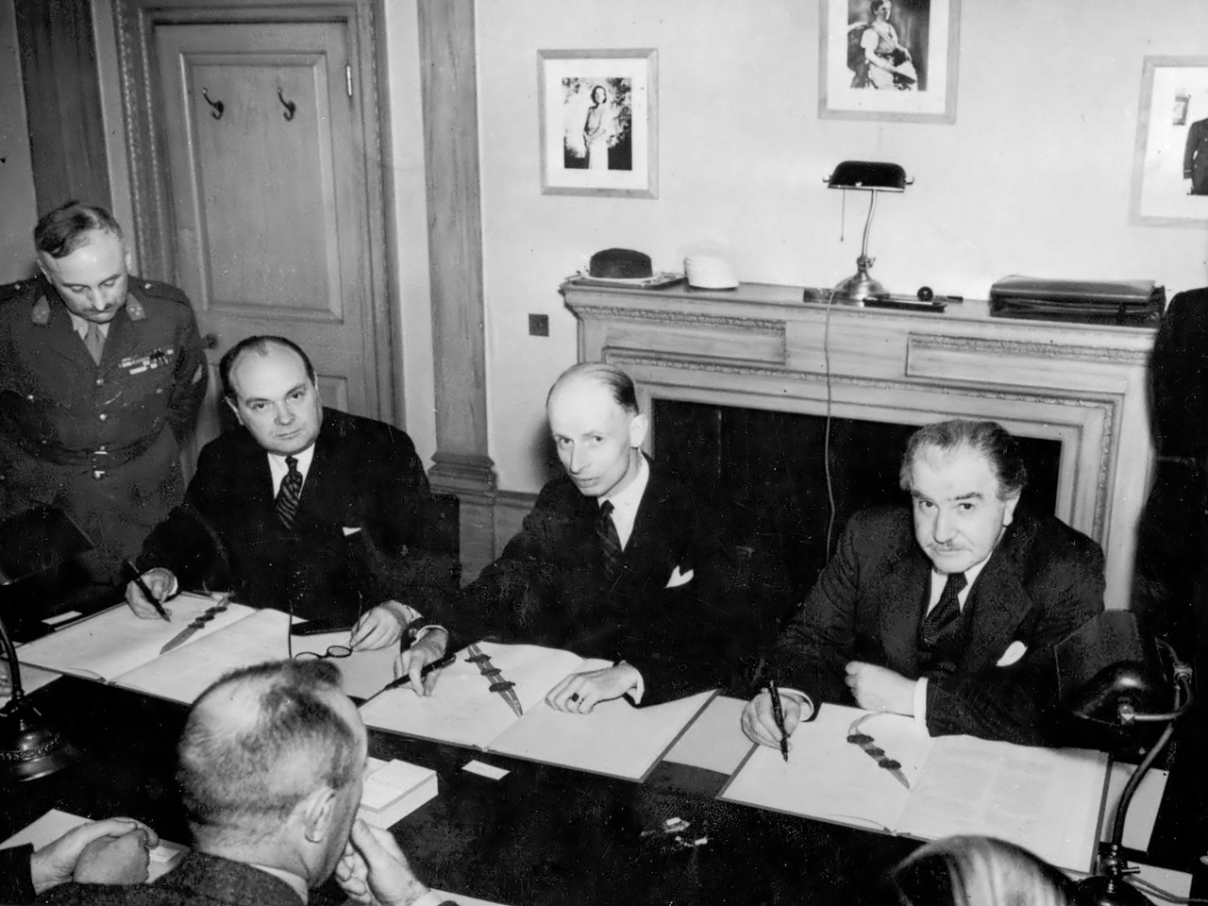
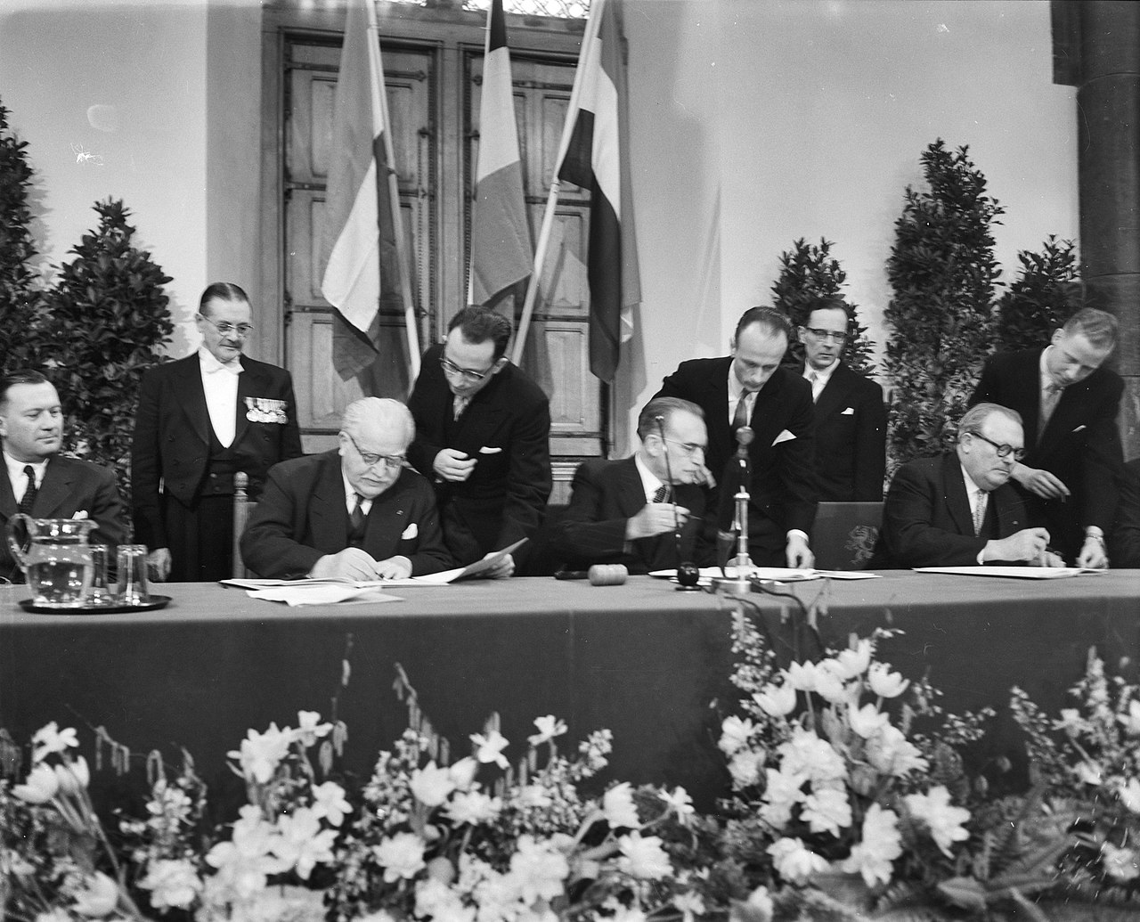
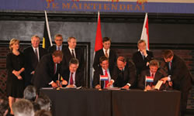
Benelux Union - history
1944: Customs Union + common external tariff between NL, BE and LU
1958: Treaty establishing the ‘Benelux Economic Union’
2008: Treaty establishing the ‘Benelux Union’

Slide 3
Cross border labour mobility: a priority for the Benelux Union
More than 35% of the total EU cross border workers live in the Benelux area: major shareholder
Border regions are missing opportunities by not using the potential of the other half of the (whole) circle
To stimulate cross border mobility, a coordinated support provided by ministries of neighboring countries is indispensable for (local) actors in border regions
- Benelux Recommendation (2014): basis for actions (Nord-Rhein-Westphalia joined)
- Regular consultations with local stakeholders, social partners and executive authorities for coordinated decisions.
- Benelux actions (including NRW) concentrate on the following pillars:
Information dissemination: information portal; brochures...
Diplomas and qualifications:
2015 Decision Higher Education
2021 Treaty with Baltic States
2023 Open treaty!
Cross-border telework
Cross-border statistics
Cross-border (public) transport

Slide 4
Cross-border
workers
Education
Mobility

Slide 5
Follow us
@beneluxunion
www.benelux.int

