Slide 1
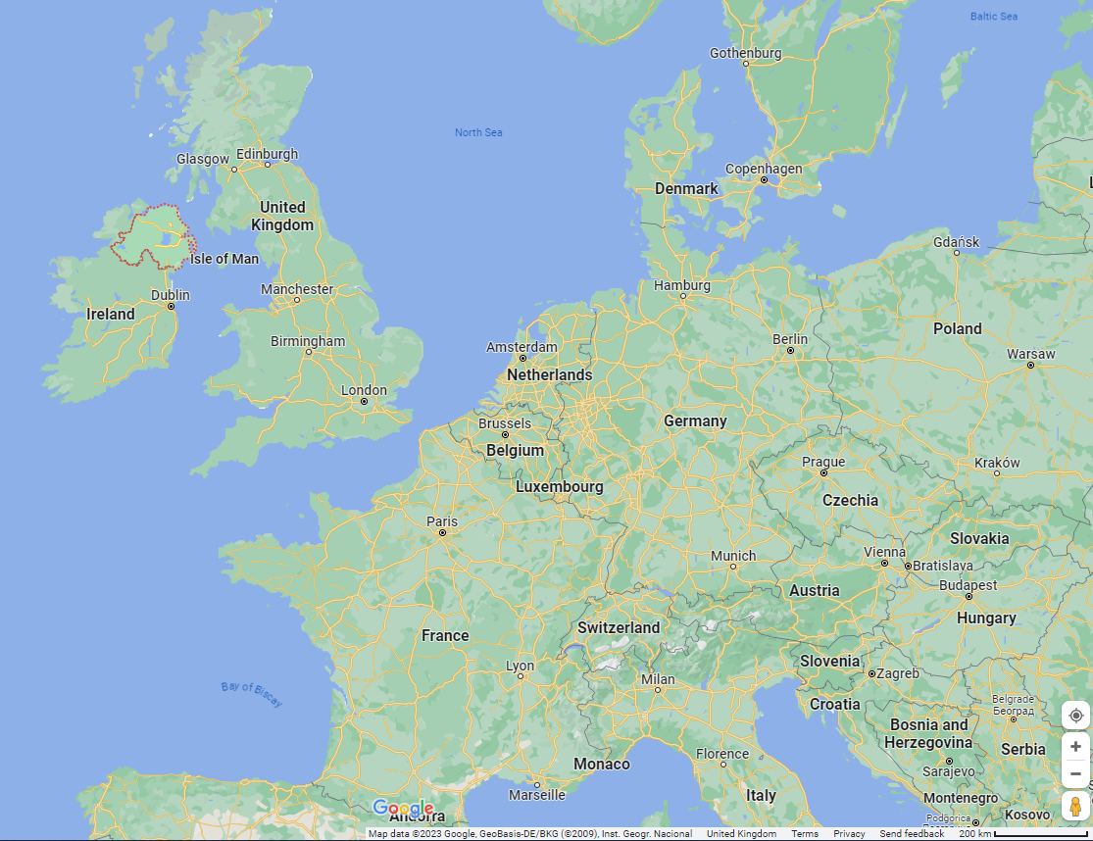
Annmarie O’Kane – borderpeople@qub.ac.uk

Slide 2
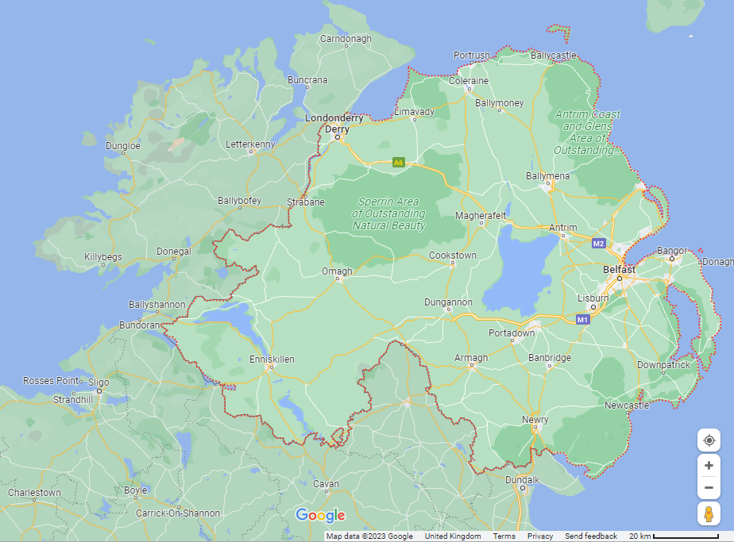

Slide 3
Rights?
Trade & Cooperation Agreement
(EU & British Citizens)
Withdrawal Agreement
EU UK
Citizens who had engaged free movement rights by 31 Dec 2020
Common Travel Area
(British & Irish Citizens)
Free movement
Social Security
Employment

Slide 4


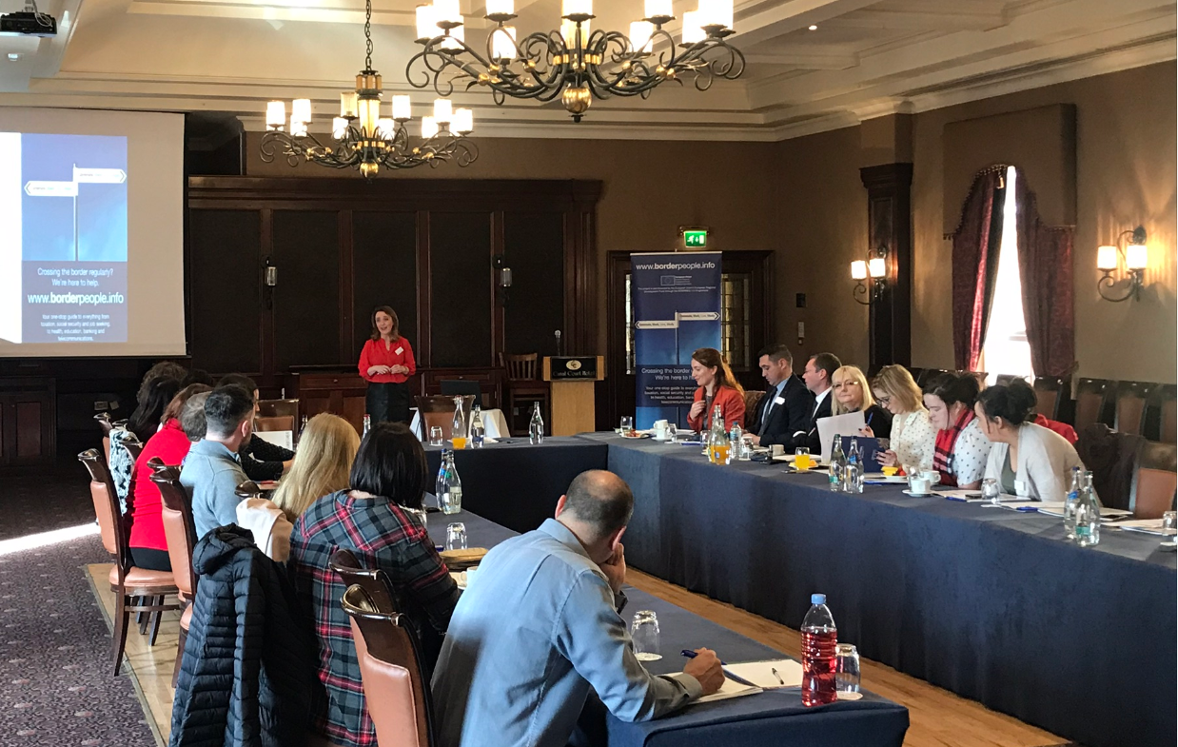
Mainstreaming
cross-border information

